Slide 1
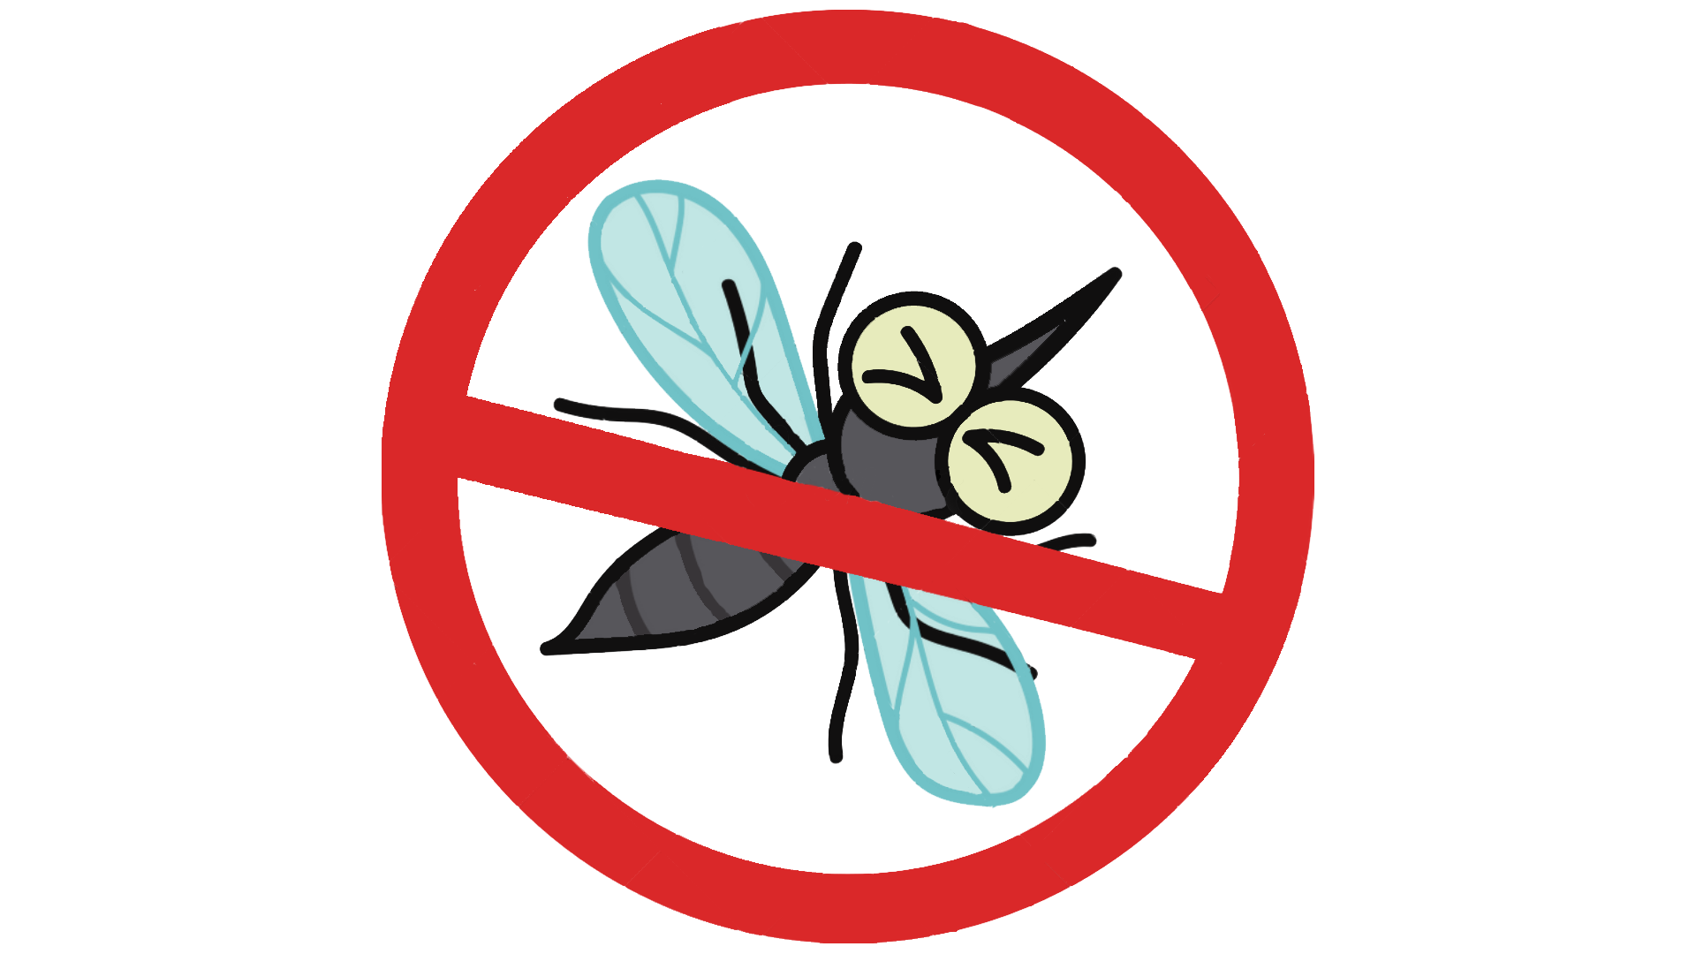
West Nile Virus Prediction
Dataya Pte Limited

Slide 2

Meeting Participants
Officials from the Department of Public Health
Team from Dataya Pte Ltd

Slide 3
Agenda
1
2
Introduction
EDA
Background,
& Data Cleaning
Exploratory data Analysis
3
4
Modeling
Conclusion
Model Evaluation
CBA & Recommendations

Slide 4
Introduction

Slide 5
Background
West Nile virus (WNV) is the leading cause of mosquito-borne disease in the continental United States.
Most commonly spread to people by the bite of an infected mosquito.
On average, 2,622 people gets infected every year and there are 122 deaths due to WNV every year.
Every week from late spring through the fall, mosquitos in traps across the city are tested for the virus.
Results of these tests influence when and where the city will spray airborne pesticides to control adult mosquito populations.

Slide 6
Problem Statement
The Department of Public Health has engaged us, an independent Data Science company, to derive an effective plan using data science methods to deploy pesticides across Chicago.
We would have to make recommendations on where pesticides should be sprayed and the cost vs benefit of deploying these pesticides.

Slide 7
Data Cleaning

Slide 8
Data Cleaning
3 different datasets: Train, ‘Spray’, ‘Weather’
Dataset | Test | Spray | Weather
No. of Columns | 12 | 4 | 22
No. of Rows | 10,506 | 14,835 | 2,944
No. Null values | 0 | 584 | 10,689
Impute all the missing values in the dataset
Remove duplicates

Slide 9
EDA

Slide 10
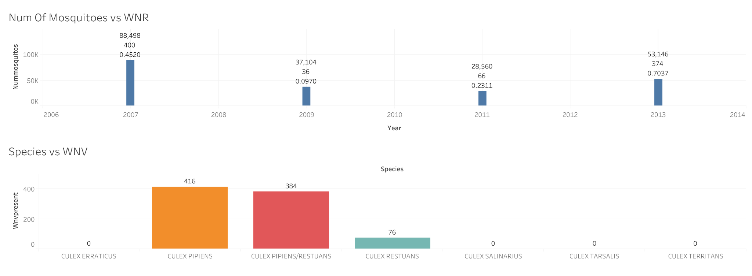
EDA : Mosquitoes Count
2 / 6 species found containing WNV

Slide 11
EDA: Features
Dew Point
Wind
Average dew point in Degrees Fahrenheit.
Average Speed Wind
T-Average
Average temperature in Degrees Fahrenheit.
Wet Bulb
Precipitation
Average wet bulb in Degrees Fahrenheit.
Water equivalent(Inches & Hundredths

Slide 12
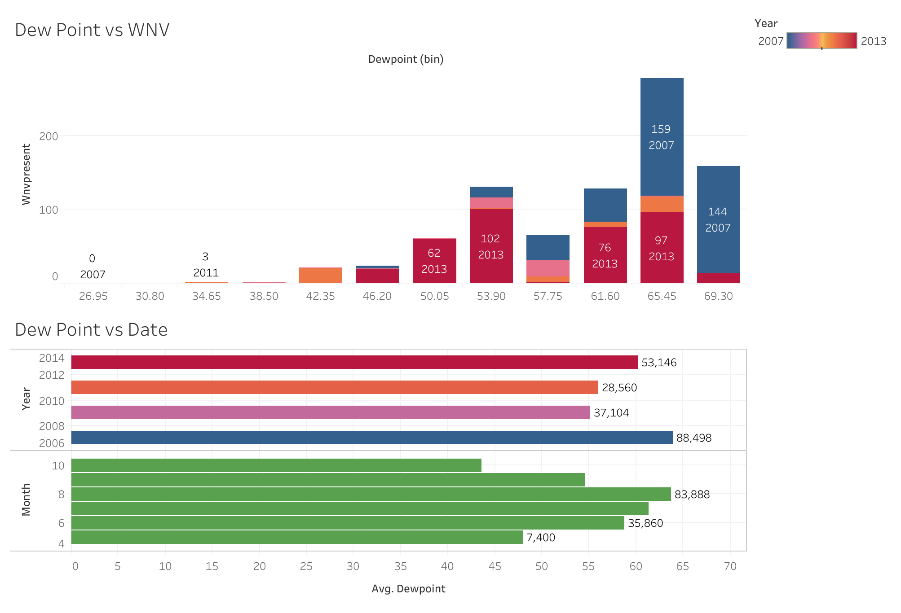
EDA : Dew Point
2007 - Blue 2009 - Pink 2011 - Orange 2013 - Red
Number of mosquitoes peak between June - Aug
High dew points counts are correlated with WNV.
High count of Mosquitoes

Slide 13
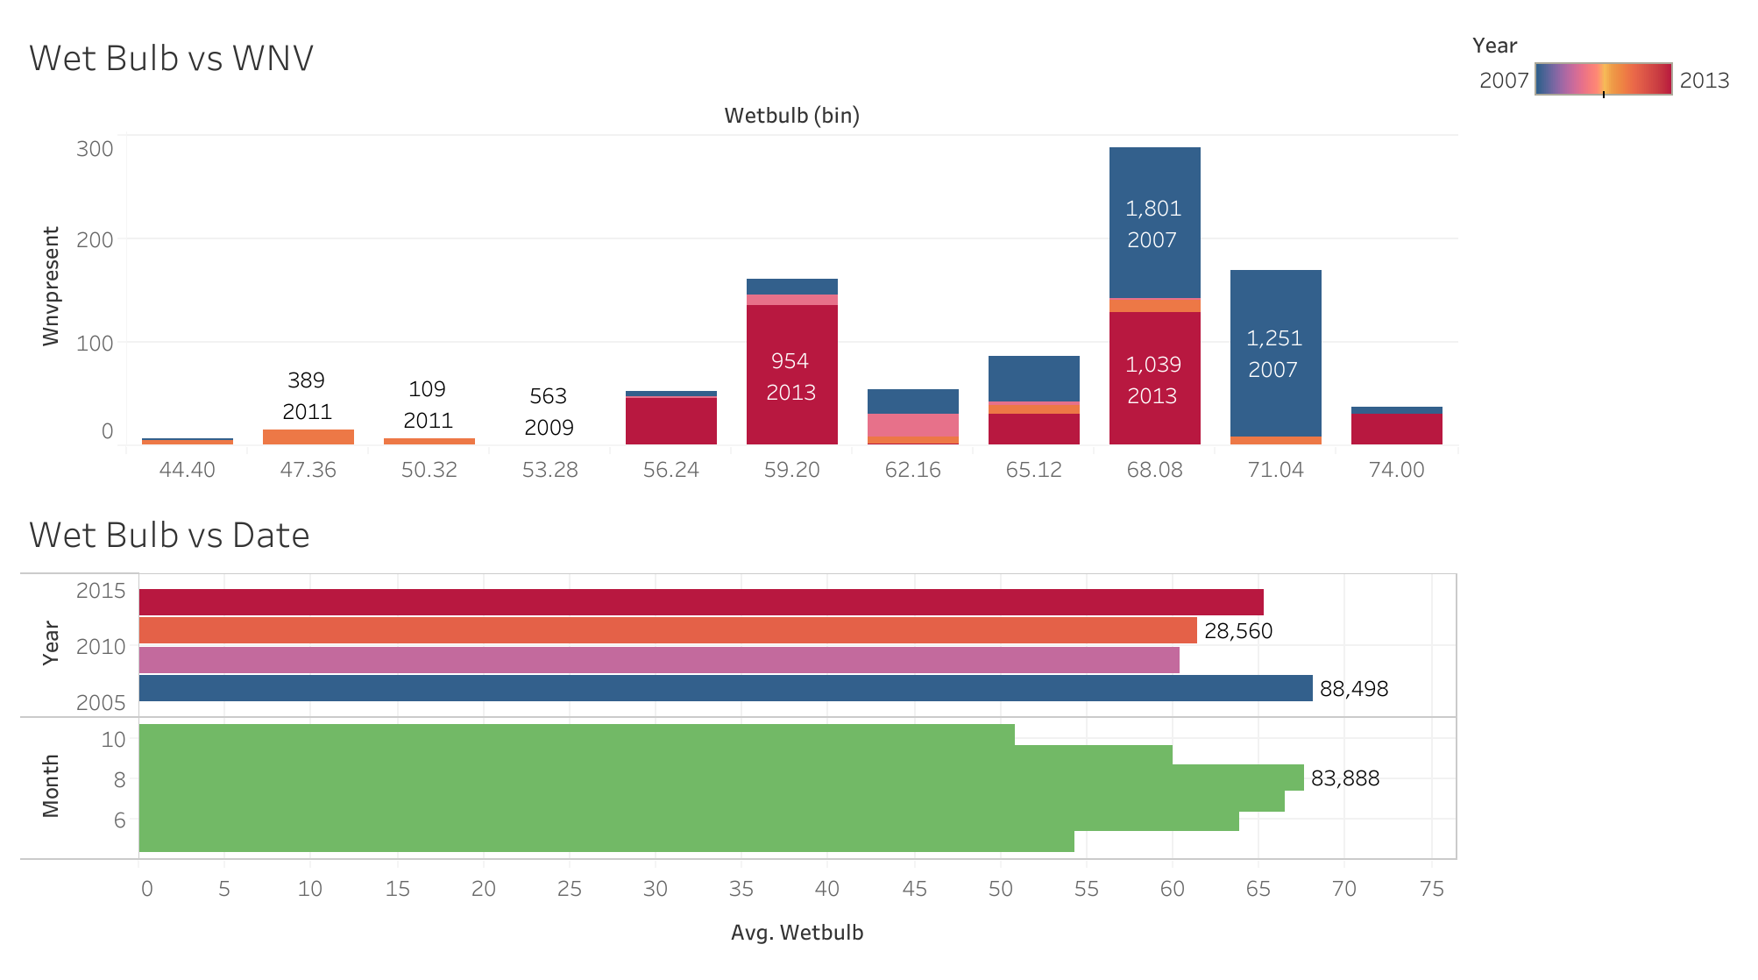
EDA : Wet Bulb
2007 - Blue 2009 - Pink 2011 - Orange 2013 - Red
Peak between July to Aug
High humidity offsets higher temperatures
Wet Bulb - humidity relationship

Slide 14
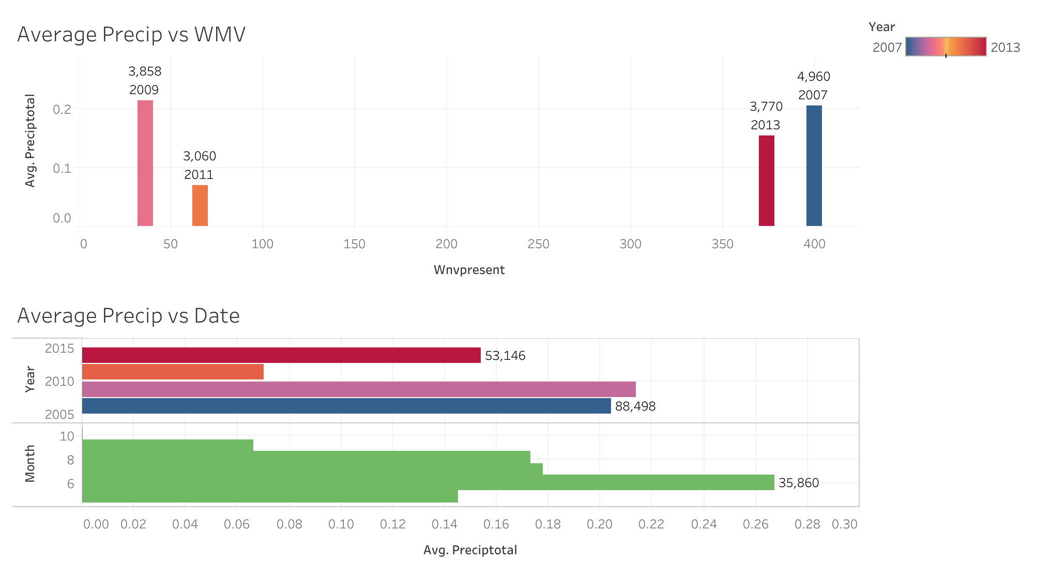
EDA : Precipitation
2007 - Blue 2009 - Pink 2011 - Orange 2013 - Red
Breeding is encouraged by precipitation.
In June, we can clearly detect a rise in mosquito populations.

Slide 15
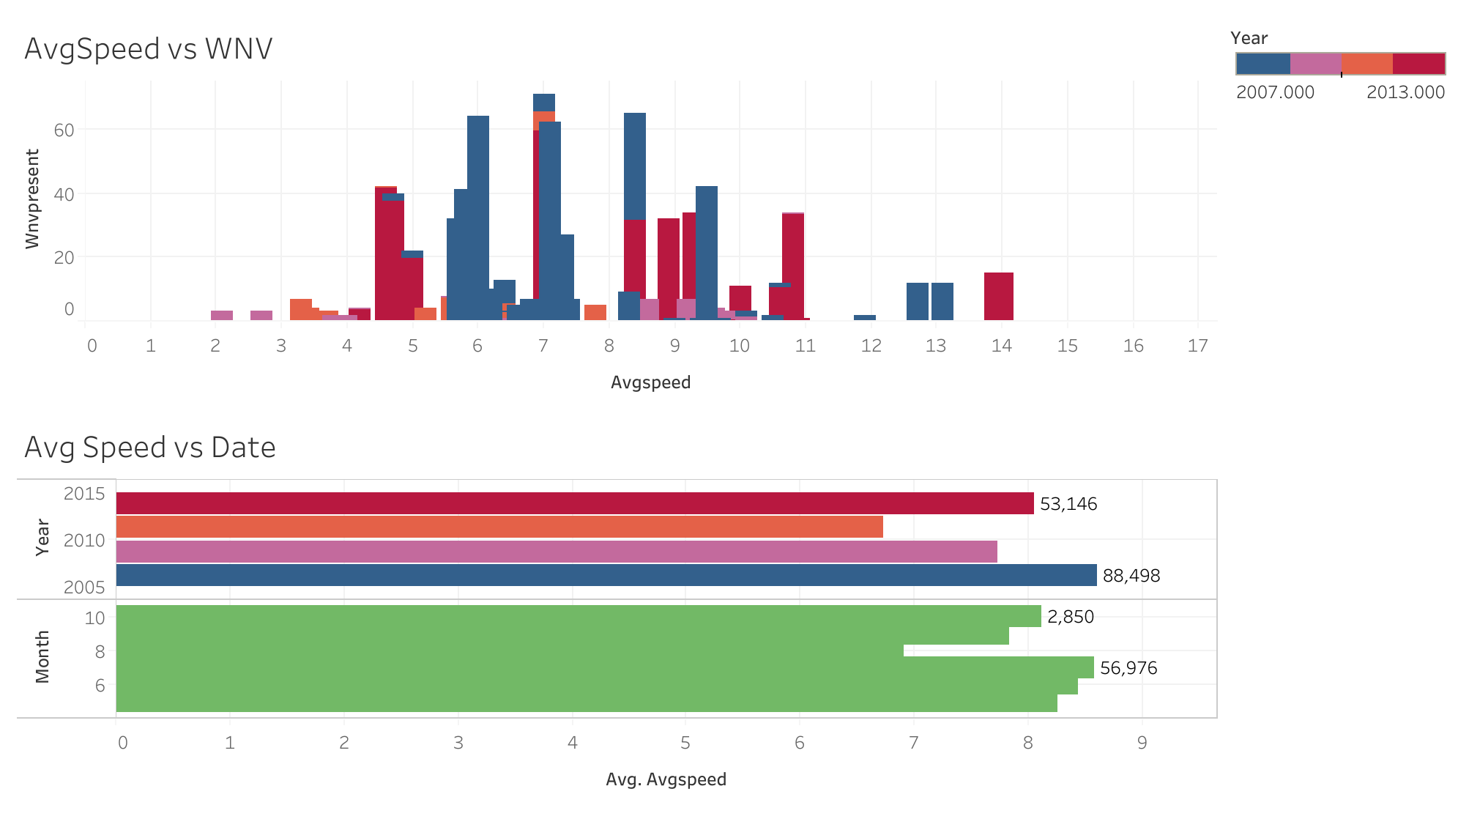
EDA : Wind Speed
2007 - Blue 2009 - Pink 2011 - Orange 2013 - Red
Higher WNV numbers are indicated by slower wind speeds.
The spray and trap's effectiveness may be impacted by wind speed.

Slide 16
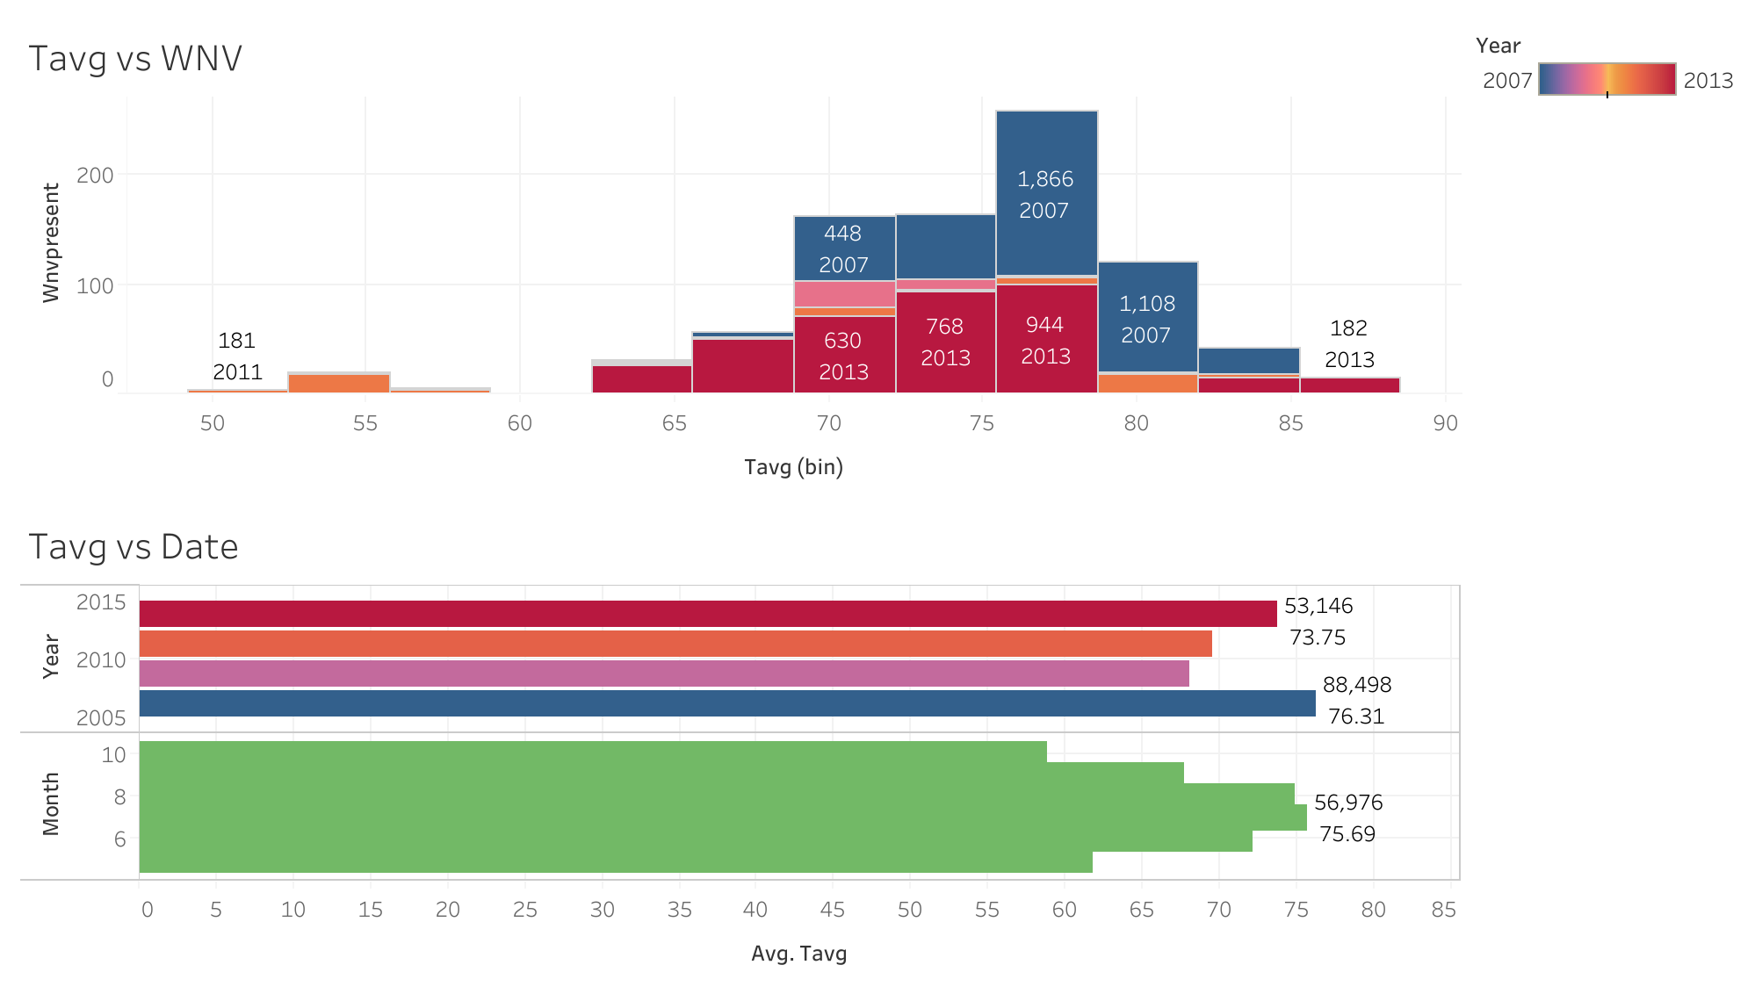
EDA : T - Average
2007 - Blue 2009 - Pink 2011 - Orange 2013 - Red
An increase in temperature during July - September Period.
Positively correlated to Number of mosquitoes
Impact of Temperature

Slide 17
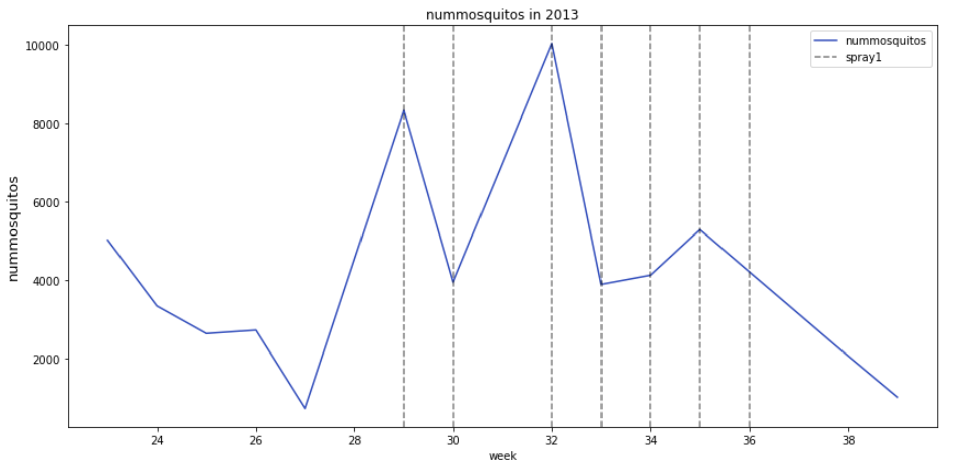
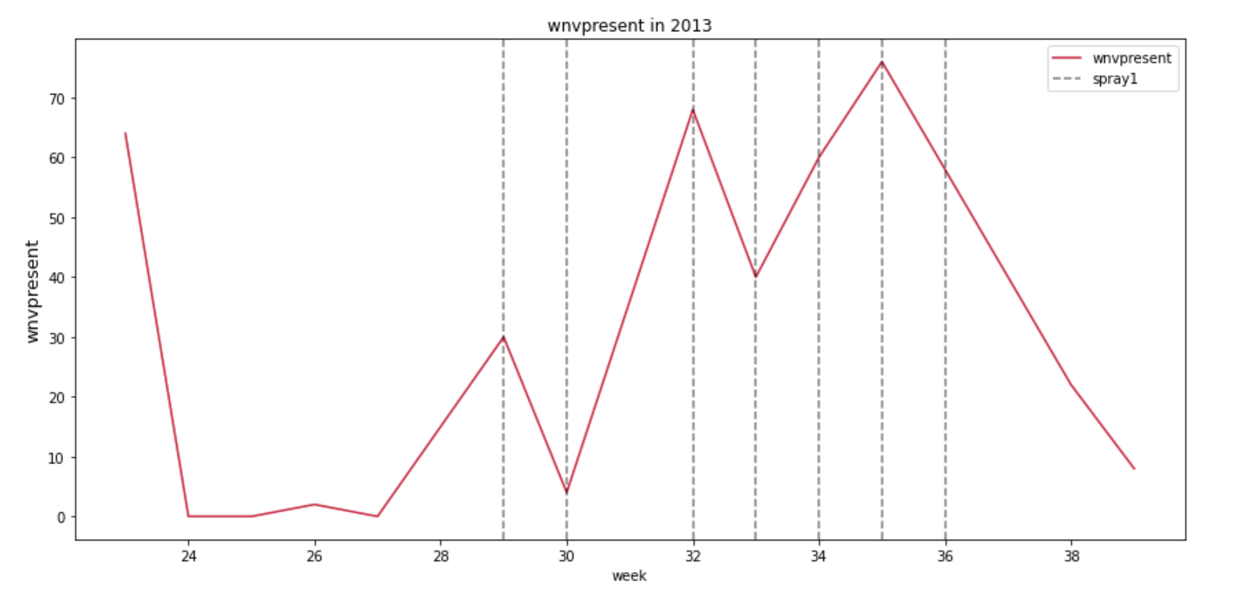
EDA : Spray
Spraying seems to reduce mosquito populations but not the spread of viruses.
Potential causes for this could be:
Improper spray targeting
Incorrect timing of sprays

Slide 18
Featuring Engineering
Relative Humidity
Average Weekly Temperature
Traps (One Hot)
Average Weekly Humidity
Species (Re-map)
Cumulative Weekly Precipitation

Slide 19
Modelling

Slide 20
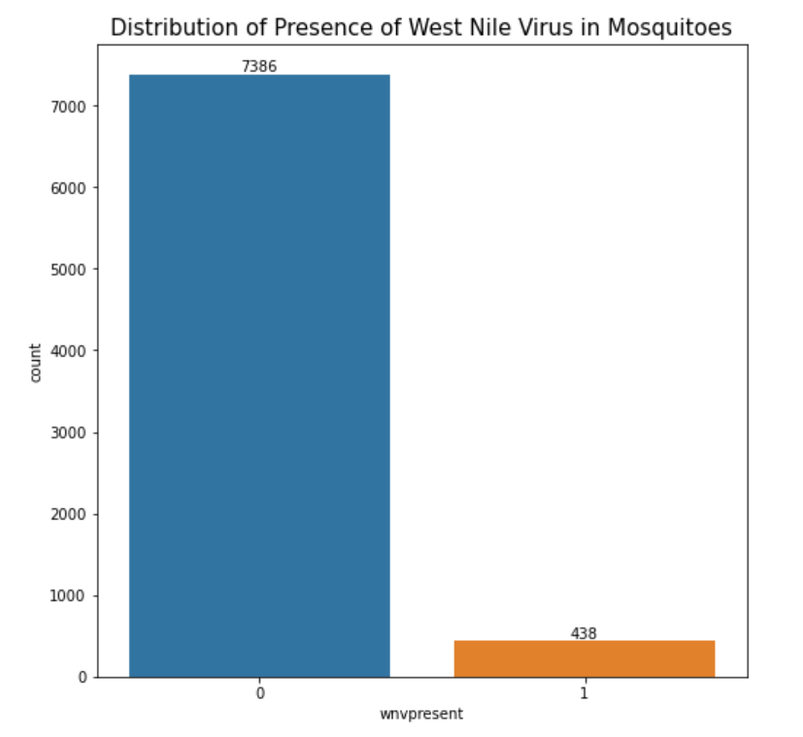
Highly Imbalanced Dataset
94.4% of the mosquitoes do not have West Nile Virus.
Only 5.6% of the data shows the presence of the West Nile Virus.
Highly imbalanced classes so we need to balance them out for better model performance.

Slide 21
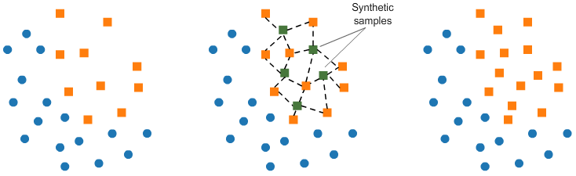
SMOTE
Synthetic Minority Oversampling Technique (SMOTE) is an oversampling technique where the synthetic samples are generated for the minority class. This will help to balance our data in order to aid our machine learning algorithms.
Source: https://medium.com/@asheshdas.ds/oversampling-to-remove-class-imbalance-using-smote-94d5648e7d35

Slide 22
Logistic Regression (Baseline Model)
After applying SMOTE on our dataset, we are able to achieve a better ROC AUC score.
Train Accuracy | 0.66341
Test Accuracy | 0.63781
ROC AUC Score | 0.63781 (vs 0.5 before SMOTE)

Slide 23
GridSearchCV (Hyperparameter Tuning)
GridSearchCV is the process of performing hyperparameter tuning in order to determine the optimal values for a given model.
We will run this for our 5 models below and evaluate their performance:
Logistic Regression
K-Nearest Neighbors
Random Forest
Ada Boost
Gradient Boosting

Slide 24
Performance Metrics
ROC-AUC score: The ROC curve is a plot of the True Positive Rate (Sensitivity) vs. the False Positive Rate for all possible decision thresholds.
The higher the AUC, the better the model is at distinguishing between whether there is WNV or not.
Sensitivity: Sensitivity is a measure of the proportion of actual positive cases that got predicted as positive (or true positive).
High sensitivity means there will be few False Negative results and thus fewer cases of WNV-positive missed out

Slide 25
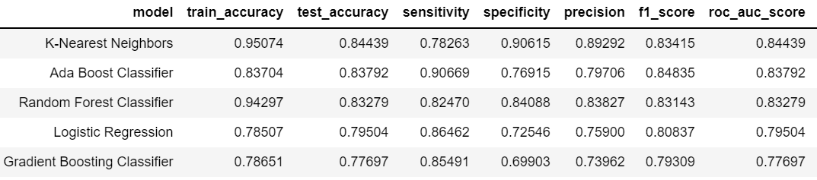
Model Evaluation
Ada Boost is the best model as it has high sensitivity and ROC AUC score.

Slide 26
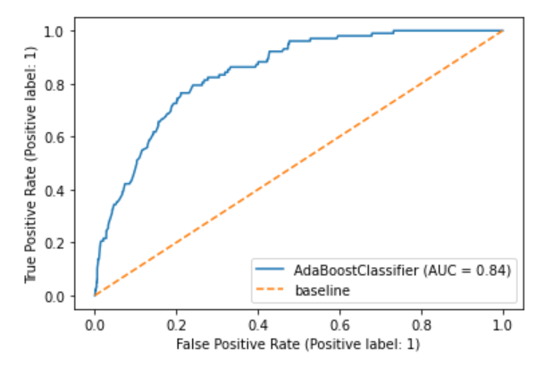
Ada Boost
ROC Curve
Confusion Matrix
TN = 1426
FP = 428
WNV-Negative (0)
True label
FN = 173
TP = 1681
WNV-Positive (1)
WNV-Negative (0)
WNV-Positive (1)
Predicted label

Slide 27
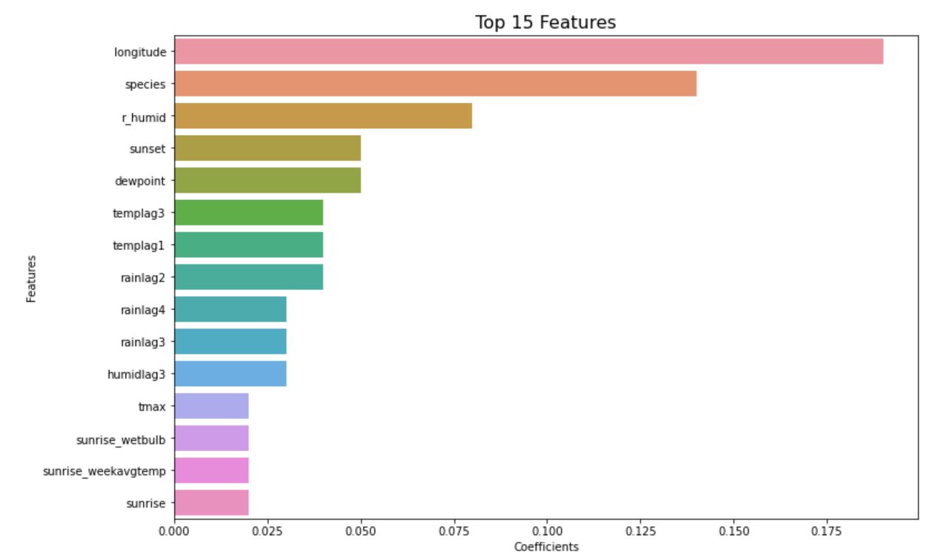
Top 15 Predictors

Slide 28
Limitations
AdaBoost model is sensitive to noise and outliers
Relatively slow and computationally expensive

Slide 29
Future Improvements
Use Principal Component Analysis to reduce dimensions and noise in the data
Apply more advanced models and compare results
eg. Support Vector Machines, XGBoost
Further hyperparameter tuning

Slide 30
Cost-Benefit Analysis & Conclusion

Slide 31
Benefits - Overview
Difficult to quantify the results of spraying
Mosquito Control is conducted in a preventive manner
Pre-emptive, not reactive!
Lack of control groups
No identical control groups
Unable to experiment due to fatal nature of virus

Slide 32
Benefits - Quantitative
Based on a study (West Nile Virus Outbreak) found in 2005:
Costs/Severity | West Nile Neuroinvasive Disease | West Nile Fever
Count | 46 | 117
Inpatient Treatment | $2,188,768* | -
Outpatient Treatment | $884,137* | $28,051*
Productivity Loss | $696,009* | $145,727*
Average | $81,392* | $1,485*
* values adjusted for inflation @ 2.15% p.a

Slide 33
Costs - Quantitative
Based on the same study,
Aerial spray would cost $861,937* for an area of 477 km²
Assuming a same distribution of the virus severity, there is a net benefit as long as a spray of similar area (477 km²) prevents 36 cases or more.

Slide 34

Benefits - Qualitative
Inevitably reduces other mosquitoes borne diseases
Higher well-being by those who consider mosquitoes pests
Regular spraying creates jobs for the state
Visible effort to residents of steps taken to prevent fatalities

Slide 35
Costs - Qualitative
Lower well-being by those who dislike the smell
Reports of pesticides causing health effects
eg. itching, convulsions, swelling, asthma
Impairs vision
Spraying often done in the morning

Slide 36
Key Takeaways
2 out of the 6 mosquito species constituted all observed presences of the WNV
The location’s longitude is the variable with the largest impact on our model’s predictions
Although the use of pesticides in the 2013 spraying data shows some effectiveness in controlling the virus,
Unable to directly compare cause and effect but there are suitable measures to take

Slide 37

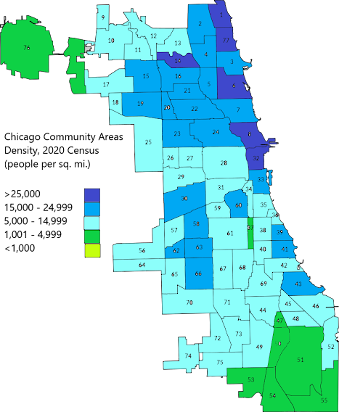
Recommendations
Focus efforts on deploying pesticides in community areas with higher density since spraying costs proportional to area
Image courtesy of: newgeography.com

Slide 38
Recommendations
Run campaigns to educate public
Best practices for prevention
Most effective approach is a joint effort between the community and government
Alert system
Inform residents in areas when up-to-date data suggests a higher likelihood of the virus

